Slide 1
Lesson 3: Variables
KS4 - Programming
Notes:
Last updated: 04-01-21
Resources are updated regularly — the latest version is available at: ncce.io/tcc.
This resource is licensed under the Open Government Licence, version 3. For more information on this licence, see ncce.io/ogl.

Slide 2
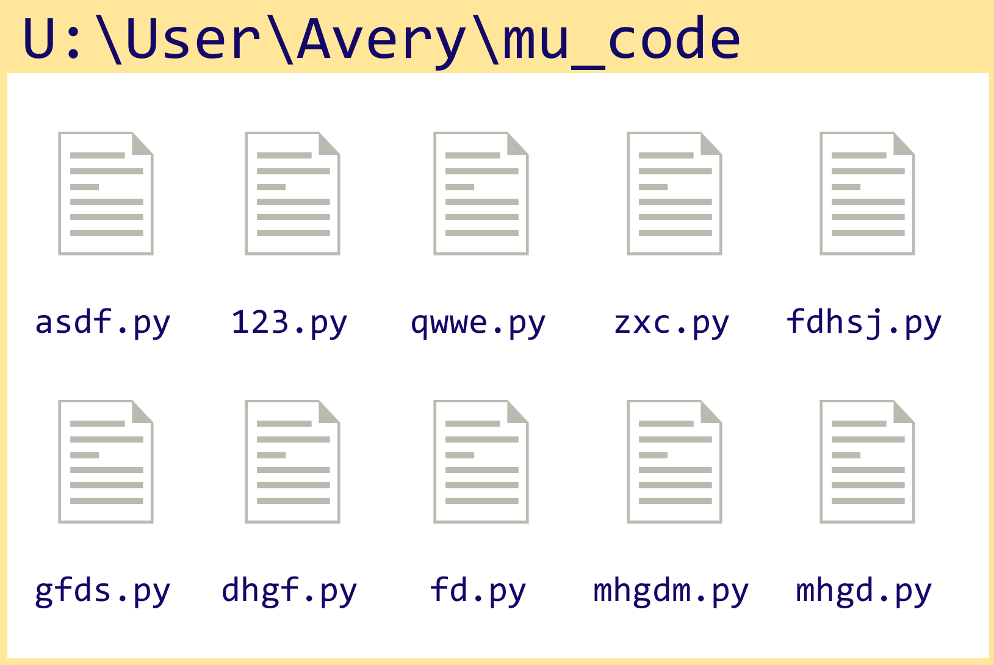
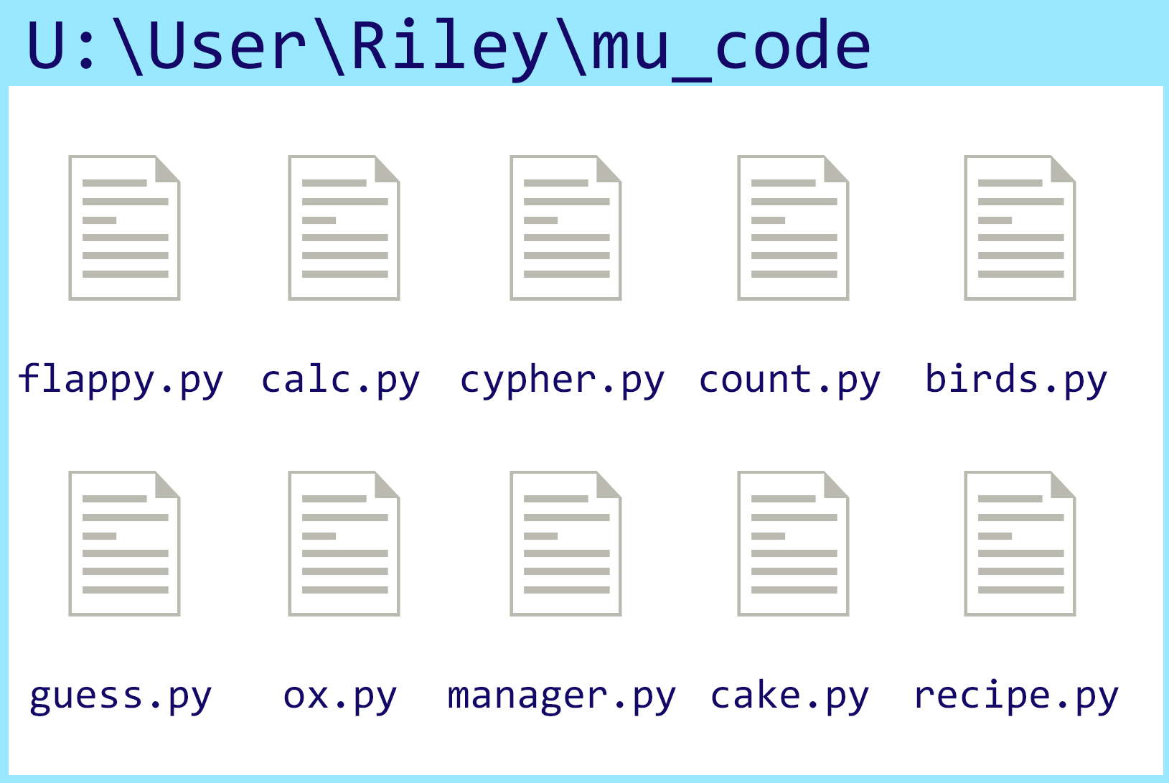
In pairs, compare and contrast these user areas
Starter activity
Who has the better user area and why?

Slide 3
Why is it important to name files correctly?
Starter activity

Slide 4

Python naming conventions
Starter activity
In programming, there are naming conventions that should be followed to make it easier to read and understand your code.
Python has an agreed set of conventions that programmers should follow.
You will explore some of these during this lesson.
age
first_name
SPEED

Slide 5

Lesson 4: Variables
Objectives
In this lesson, you will:
Use meaningful identifiers
Determine the need for variables
Distinguish between declaration, initialisation, and assignment of variables
Demonstrate appropriate use of naming conventions
Output data (e.g. print (my_var))

Slide 6

What can you do in Python?
Activity 1
Previously you have:
Written a program in a sequence
Used the print function
Used a subroutine
Checked for errors in your code
Fixed common errors in your code
This lesson, you will be introduced to a new programming construct known as a variable.

Slide 7
What is a variable?
Activity 1
A variable holds a value in a memory location that is needed for the execution of your program.
A variable can hold one value at a time. This value can change throughout the execution of the program.

Slide 8
What is a variable?
Activity 1
You might use a variable to keep track of the score for a game.
At the beginning of a game the score might be 0.
score
0

Slide 9
What is a variable?
Activity 1
You might use a variable to keep track of the score for a game.
At the beginning of a game the score might be 0.
During gameplay, the player might earn a point.
score
0
score = score + 1

Slide 10
What is a variable?
Activity 1
You might use a variable to keep track of the score for a game.
At the beginning of a game the score might be 0.
During gameplay, the player might earn a point.
This would change the value held in score by increasing the value by 1.
score
1
score = score + 1

Slide 11
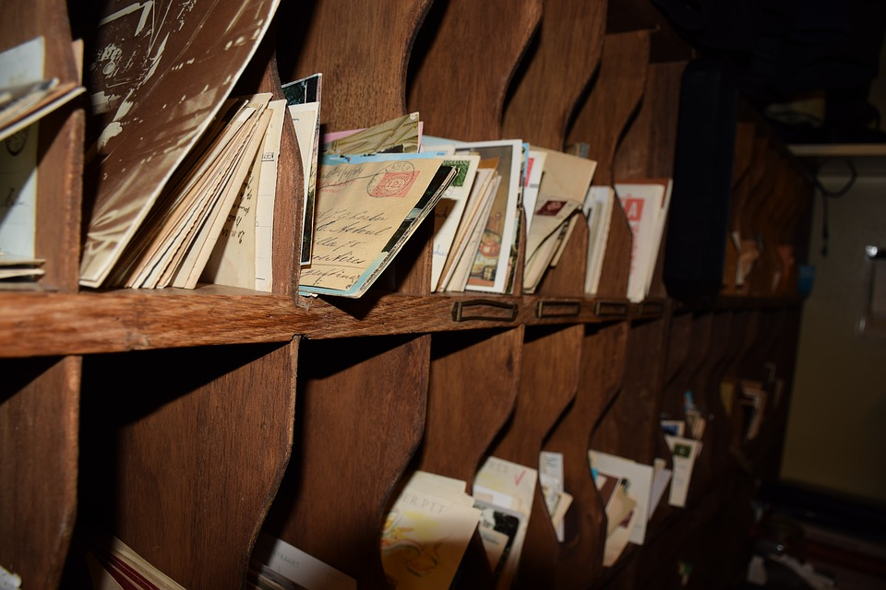
Using a variable
Activity 1
A memory location needs to be allocated for the variable value, before it can be used by the program.
Declaring a variable means stating what data type will be used for the value.
Initialising a variable means setting the initial value.
Notes:
Image source: https://pixabay.com/photos/post-post-office-letter-old-3471110/

Slide 12
Variable declaration in other programming languages
Activity 1
Python doesn’t use variable declaration, only initialisation.
Here are examples of variable declaration in Visual Basic and C.
Integer or int just means whole numbers.
Both of these statements mean declare the variable age as an integer.
Visual Basic
Dim age As Integer
C
int age;

Slide 13
Variable initialisation
Activity 1
Initialisation is when the initial value is assigned to the variable.
Remember that variables only hold one value at a time and this value can change throughout the execution of the program.
Here are examples of variable initialisation. This means hold the value 22 under the variable name, age.
Visual Basic
age = 22
C
age = 22;
Python
age = 22

Slide 14
Creating and using our first variable
Activity 1
Line 1 initialises the variable by calling it name and assigning the value “Gerry” at a memory location.
Activity
Type this code into Python and run it to see what happens.
Swap lines 1 and 2 around and read the error message that occurs.
1
2
3
name="Gerry"
print(name)

Slide 15
Creating and using our first variable
Activity 1
When you try to use a variable before it has been initialised, it will cause an error.
Instructions are executed one after the other.
In this case the error would be:
name, ‘name’ is not defined
1
2
3
print(name)
name="Gerry"
Traceback (most recent call last):
File "c:\users\rebecca\mu_code\name.py", line 1, in <module>
print(name)
NameError: name 'name' is not defined

Slide 16
Creating and using our first variable
Activity 1
Once a variable has been initialised with its first value, it can then be reassigned a new value throughout the execution of the code.
Question .
What do you think might happen when this code is executed?
1
2
3
name="Gerry"
name="Sam"
print(name)

Slide 17
Creating and using our first variable
Activity 1
The program will display Sam on the screen. This is because it was the last value that was assigned to name.
1
2
3
name="Gerry"
name="Sam"
print(name)
Sam
>>>

Slide 18

Meaningful identifiers and naming conventions
Activity 1
Variables should always be identified in a meaningful way, like the files from the starter activity.
a, b, c, x, y are not helpful names for a variable.
If a variable is going to hold a name, then call that variable name.
x = "Gerry"
name = "Gerry"
Notes:
Image source: https://pixabay.com/vectors/check-cross-red-green-attention-158879/

Slide 19
Meaningful identifiers and naming conventions
Activity 1
All programming languages have their own naming conventions.
A considerate programmer will read the documentation for the programming language to find out what the conventions are.
In Python, variable names should be written in lower case, with an underscore separating words if required.
ncce.io/pythondoc

Slide 20
Recap
Activity 1
Declaration means to declare a variable as a certain data type.
Initialisation means to set an initial value for a variable.
Assignment means to change the value held at the variable location.
A variable must be initialised before it can be used.
Meaningful identifiers are essential.

Slide 21
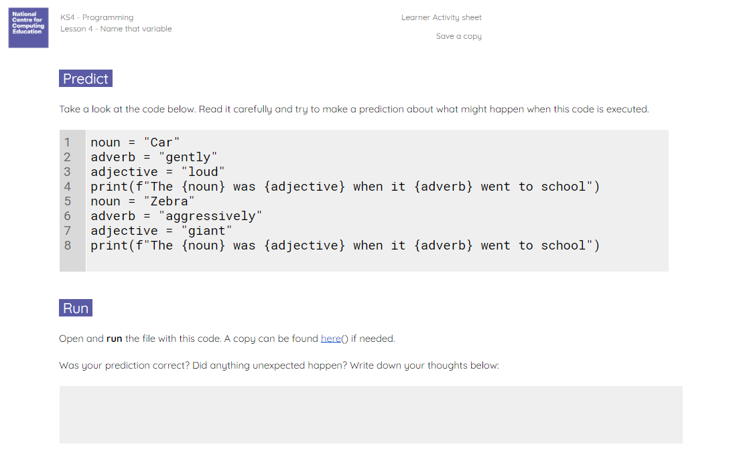
Silly sentences
Activity 2
Use the Activity 2 worksheet to predict, run, investigate, and modify a silly sentences program.
The final task is to create your own silly story.

Slide 22
Peer-review your silly stories
Plenary
Sit with a partner and peer-review your silly stories. A checklist has been provided to focus your review.
Has the programmer used a variety of variables to fill in the blanks?
Are there any syntax errors?
Are they any logic errors?
How could the story be improved?

Slide 23

Improve your silly stories
Homework
Based on the feedback from your partner, improve your silly stories program.
Due next lesson
Notes:
Image source: https://pixabay.com/photos/grimace-funny-expression-mask-388987/

Slide 24
Next lesson
Summary
In this lesson, you…
Learnt how to use variables in your programs.
Next lesson, you will…
Learn how to accept user input into your program.

